Slide 1

Principles of Compiler Construction
Lecturer: 常会友
Note that most of these slides were created by:
Prof. Wen-jun LI
Dr. Zhong-mei SHU
Dr. Han LIN
© Copyright 2008-2011, Sun Yat-sen University

Slide 2
Lecture 9. Semantic Analysis and Intermediate Code Generation
Introduction
Types and Declarations
Assignments and Expressions
Type Checking
Boolean Expressions
Backpatching and Flow-of-Control Statements

Slide 3
1. Introduction
Review
Front end vs. back end
m × n: m front ends and n back ends.
Interface between front ends and back ends
Intermediate representation
Why IR ? Extendability and optimization.
Semantic (static) analysis
The most common analysis
Type checking
Other static checking
Unreachable code
Use of uninitialized variables
etc.

Slide 4
Static Checking
Semantic analysis also focuses on the well-formness of source code
Due to the expressiveness power of Context-Free Grammars.
For example,
Number matching of actual parameters.
Context sensitive requirements cannot be specified using a context free grammar.
break statement must be in a loop or switch.
Requires a complicated and unnatural context free grammar.

Slide 5
Intermediate Representation
High level intermediate representations
AST and DAG
Suitable for tasks like static type checking
Low level intermediate representations
3-address code: x = y op z
Suitable for machine-dependent tasks, such as register allocation and instruction selection.
IR choice/design are application specific
C language is commonly used (AT&T Bell Lab Advanced C++)

Slide 6
Three-Address Code
Compiler-generated temporary variables
x + y * z
t₁ = y * z t₂ = x + t₁
An example
t₁ = b – c t₂ = a * t₁ t₃ = a + t₂ t₄ = t₁ * d t₅ = t₃ + t₄
+
+
*
d
*
a
–
b
c

Slide 7
Addresses
Addresses in 3-address code
Name (variables in source code)
May be implemented as a pointer or reference to its entry in the symbol table.
Constant
Type conversions must be considered.
Compiler-generated temporary
Useful for optimization.
Register allocation.

Slide 8
Instructions
Common 3-address instructions
x = y op z // arithmetic and logical x = op y // negation and conversion x = y // copy
goto L // unconditional jump if x goto L // conditional jump ifFalse x goto L // conditional jump if x op y goto L // relational operation
param x₁ // parameter passing param x₂ ... param x_{n} call p, n // procedure call y = call p, n // function call return y // return a value

Slide 9
Instructions (cont')
Common 3-address instructions
x = y[i] // indexed copy, i is the offset x[i] = y
x = &y // address and pointer assignment x = *y *x = y

Slide 10
Three-Address Code: Example
Source code
do i = i + 1; while (a[i] < v);
Translation to 3-address code (symbolic labels)
L: t₁ = i + 1 i = t₁ t₂ = i * 8 t₃ = a[t₂] if t₃ < v goto L
Another translation form (position numbers)
100: t₁ = i + 1 101: i = t₁ 102: t₂ = i * 8 103: t₃ = a[t₂] 104: if t₃ < v goto 100

Slide 11
Implementations of Three-Address Code
Quadruples (quads)
Pros and cons ?
Triples
Pros and cons ?
Indirect triples
Pros and cons ?
Space consuming
Flexibility to optimizations

Slide 12
1) Quadruples
Source code
a = b * – c + b * – c
Three-address code
t₁ = minus c t₂ = b * t₁ t₃ = minus c t₄ = b * t₃ t₅ = t₂ + t₄ a = t₅
Quads
 | op | arg₁ | arg₂ | result
0 | minus | c |  | t₁
1 | * | b | t₁ | t₂
2 | minus | c |  | t₃
3 | * | b | t₃ | t₄
4 | + | t₂ | t₄ | t₅
5 | = | t₅ |  | a
... | ...

Slide 13
2) Triples
Three-address code
t₁ = minus c t₂ = b * t₁ t₃ = minus c t₄ = b * t₃ t₅ = t₂ + t₄ a = t₅
 | op | arg₁ | arg₂
0 | minus | c
1 | * | b | (0)
2 | minus | c
3 | * | b | (2)
4 | + | (1) | (3)
5 | = | a | (4)
... | ...

Slide 14
3) Indirect Triples
Three-address code
t₁ = minus c t₂ = b * t₁ t₃ = minus c t₄ = b * t₃ t₅ = t₂ + t₄ a = t₅
 | op | arg₁ | arg₂
0 | minus | c
1 | * | b | (0)
2 | minus | c
3 | * | b | (2)
4 | + | (1) | (3)
5 | = | a | (4)
... | ...
35 | (0)
36 | (1)
37 | (2)
38 | (3)
39 | (4)
40 | (5)
... | ...
In Java, array of instruction objects

Slide 15
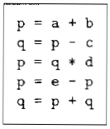
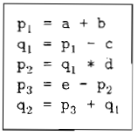
Static Single-Assignment Form

Slide 16


Static Single-Assignment Form

Slide 17
2. Types and Declarations
Declaration
Literals: implicitly
Variables: explicitly
Other names: explicitly
Type checking in strong-typing languages
Type compatibility
Type inference
Implicit type conversion
Resolving overloading operators

Slide 18
Relative address

Slide 19
Type Expressions
Declare only one name at a time
Basic Type;
Type name;
Array type constructor;
Record; (Struct , Union)
Type constructor ->;
Cartesian product;
Type expression contain variables whose values are type expressions.

Slide 20
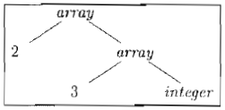
Type Expressions

Slide 21
Type Structures (cont')
Type structure for int[2][3]
T.type = array(2, array(3, integer))
B.type = integer
C.base = integer
C.type = array(2, array(3, integer))
int
C.base = integer
C.type = array(3, integer)
[
2
]
[
3
]
C.base = integer
C.type = integer
ε

Slide 22
Type Equivalence
The same basic type;
Formed by applying the same constructor to structurally equivalent types;
One is a type name that denotes the other.

Slide 23
Simplified Grammar
Declare only one name at a time
D → T id ; D | ε
T → B C | record { D }
B → int | double
C → [ num ] C | ε

Slide 24
Translation of Type Declarations
Computing types and their widths
T → B { t = B.type; w = B.width }
C { T.type = C.type; T.width = C.width }
B → int { B.type = INTEGER; B.width = 4 }
B → double { B.type = DOUBLE; B.width = 8 }
C → [ num ] C₁ { C.type = array(num.value, C₁.type);
C.width = num.value × C₁.width }
C → ε { C.type = t; C.width = w }
Type expression
Just try it: int[2][3]
What is T.type and T.width ?

Slide 25
Translation of Type Declarations (cont')
Computing relative addresses
P → { offset = 0 }
D
D → T id ; { top.put(id.lexeme, T.type, offset);
offset += T.width }
D₁
D → ε
top denotes the current symbol table
Embedded actions can be removed with markers

Slide 26
Another Example
DBv1
Enter types and their widths
P → { offset = 0 }
D
D → D ; D
D → id : T { table.enter(id.name, T.type, offset);
offset += T.width }
T → integer { T.type = INTEGER; T.width = 4 }
T → real { T.type = REAL; T.width = 8 }
T → array [ num ] of T₁ { T.type = array(num.value, T₁.type);
T.width = num.value × T₁.width }
T → ^ T₁ { T.type = pointer(T₁.type);
T.width = 4 }
Just try it: k: array [5] of ^real
What are the side effects ?

Slide 27
Another Example (cont')
DBv1
Field names in records
T → record { tableStack.push(new Table(null));
offsetStack.push(0) }
D end { T.type = record(tableStack.top());
T.width = offsetStack.top();
tableStack.pop();
offsetStack.pop() }

Slide 28
3. Assignments and Expressions
Intermediate code generation
Code concatenation
gen(...)
||
No side effects
Incremental generation
DBv1: emit(...)
DBv2: overloading gen(...)
Side effects

Slide 29

Example:

Slide 30
Translation of Expressions
Code concatenation (syntax-directed definition)
 | Productions | Semantic Rules
1 | S → id = E ; | S.code = E.code || gen(top.get(id.lexeme) '=' E.addr)
2 | E → E₁ + E₂ | E.addr = new Temp(); E.code = E₁.code || E₂.code || gen(E.addr '=' E₁.addr '+' E₂.addr)
3 | E → – E₁ | E.addr = new Temp(); E.code = E₁.code || gen(E.addr '=' 'minus' E₁.addr)
4 | E → ( E₁ ) | E.addr = E₁.addr; E.code = E₁.code
5 | E → id | E.addr = top.get(id.lexeme); E.code = ' '

Slide 31
Translation of Expressions (cont')
Incremental translation (translation scheme)
S → id = E ; { gen(top.get(id.lexeme) '=' E.addr) }
E → E₁ + E₂ { E.addr = new Temp();
gen(E.addr '=' E₁.addr '+' E₂.addr) }
E → – E₁ { E.addr = new Temp();
gen(E.addr '=' 'minus' E₁.addr) }
E → ( E₁ ) { E.addr = E₁.addr }
E → id { E.addr = top.get(id.lexeme) }

Slide 32
Another Example
DBv1
Declared variables
S → id := E ; { p = symbolTable.lookup(id.name);
if (p == null) throw new SomeException();
emit(p '=' E.place) }
E → E₁ + E₂ { E.place = new Temp();
emit(E.place '=' E₁.place '+' E₂.place) }
E → – E₁ { E.place = new Temp();
emit(E.place '=' 'minus' E₁.place) }
E → ( E₁ ) { E.place = E₁.place }
E → id { p = symbolTable.lookup(id.name);
if (p == null) throw new SomeException();
E.place = p }

Slide 33
Addressing Array Elements
2-dimensional array layout
Row major vs. column major
A[1, 1]
A[1, 1]
1st column
1st row
A[1, 2]
A[2, 1]
A[1, 3]
A[1, 2]
2nd column
A[2, 1]
A[2, 2]
2nd row
A[2, 2]
A[1, 3]
3rd column
A[2, 3]
A[2, 3]

Slide 34
Addressing Array Elements
Relative address of array elements
A[i]
base + (i – low) × w
i × w + (base – low × w)
A[i₁, i₂]
base + ((i₁ – low₁) × n₂ + i₂ – low₂) × w
((i₁ × n₂) + i₂) × w + (base – (low₁ × n₂ + low₂) × w)
A[i₁, i₂, ..., i_{k}]
((...((i₁ × n₂ + i₂) × n₃ + i₃)...) × n_{k} + i_{k}) × w + base – ((...((low₁×n₂ + low₂)×n₃ + low₃)...)×n_{k} + low_{k}) × w
Constant
for optimization

Slide 35
Addressing Tips
For each increment of a new dimension, addressing is calculated recursively, e.g. from k to k + 1
For variable part V: V × n_{k+1} + i_{k+1}
For constant part C: C × n_{k+1} + low_{k+1}

Slide 36
Grammar for Array References
Array references in Pascal: a[2, 3]
L → id [ Elist ] | id
Elist → Elist , E | E
Grammar transformation (why ?)
L → Elist ] | id
Elist → Elist , E | id [ E
L
L
id
[
Elist
]
id
[
Elist
]
Elist
,
E
Elist
,
E
E
id
[
E

Slide 37
Translation Scheme
DBv1
Addressing array elements in Pascal
(1) S → L := E { if (L.offset == null) emit(L.place '=' E.place)
else emit(L.place '[' L.offset ']' '=' E.place) }
(2) E → E₁ + E₂ { E.place = new Temp();
emit(E.place '=' E₁.place '+' E₂.place) }
(3) E → ( E₁ ) { E.place = E₁.place }
(4) E → L { if (L.offset == null) E.place = L.place
else {
E.place = new Temp();
emit(E.place '=' L.place '[' L.offset ']')
} }
(5) L → Elist ] { L.place = new Temp();
emit(L.place '=' constant(Elist.array));
L.offset = new Temp();
emit(L.offset '=' Elist.place '*' width(Elist.array) }
(6) L → id { L.place = id.place;
L.offset = null }
L.place = base – C * w
L.offset = V * w
L is a simple id (if L.offset is null) or an array reference

Slide 38
Translation Scheme (cont')
DBv1
Addressing array elements in Pascal (cont')
(7) Elist → Elist₁ , E { t = new Temp();
m = Elist₁.ndim + 1;
emit(t '=' Elist₁.place '*' limit(Elist₁.array, m));
emit(t '+=' E.place);
Elist.array = Elist₁.array;
Elist.place = t;
Elist.ndim = m }
(8) Elist → id [ E { Elist.array = id.place;
Elist.place = E.place;
Elist.ndim = 1 }
Elist.array = base
Elist.place = V Elist.ndim = dimensions

Slide 39
Another Translation Scheme
Array references in C/C++: a[2][3]
For all n, low_{n} = 0
Addressing formula
A[i]
base + i × w
A[i₁][i₂]
base + i₁ × w₁ + i₂ × w₂
w₁ is the width of a row
w₂ is the width of an element in a row
A[i₁][i₂]...[i_{k}]
base + i₁ × w₁ + i₂ × w₂ + ... + i_{k} × w_{k}
Java does NOT use
row-major storage for arrays

Slide 40
Another Translation Scheme (cont')
Translation scheme
S → id = E ; { gen(top.get(id.lexeme) '=' E.addr) }
S → L = E ; { gen(L.array.base '[' L.addr ']' '=' E.addr) }
E → E₁ + E₂ { E.addr = new Temp();
gen(E.addr '=' E₁.addr '+' E₂.addr) }
E → id { E.addr = top.get(id.lexeme) }
E → L { E.addr = new Temp();
gen(E.addr '=' L.array.base '[' L.addr ']') }
L → id [ E ] { L.array = top.get(id.lexeme);
L.type = L.array.type.element;
L.addr = new Temp();
gen(L.addr '=' E.addr '*' L.type.width) }
L → L₁ [ E ] { L.array = L₁.array;
L.type = L₁.type.element;
t = new Temp();
L.addr = new Temp();
gen(t '=' E.addr '*' L.type.width);
gen(L.addr '=' L₁.addr '+' t) }
L only for array reference
E.addr = E.place
L.array.base = L.place
L.addr = L.offset

Slide 41
4. Type Checking
Strong typing vs. weak typing
Strongness is relative
Type definitions
Primitive types: enumeration of constant
Composite types: type expressions
Type of functions: signatures
if f has type s → t and x has type s then expression f(x) has type t

Slide 42
Translation Scheme: An Example
Type checking, inference and implicit casting
E → E₁ * E₂ { E.place := new Temp();
if (E₁.type == TK_INT && E₂.type == TK_INT) {
emit(E.place '=' E₁.place '*_{int}' E₂.place);
E.type = TK_INT;
} elsif (E₁.type == TK_REAL && E₂.type == TK_REAL) {
emit(E.place '=' E₁.place '*_{real}' E₂.place);
E.type = TK_REAL;
} elsif (E₁.type == TK_INT && E₂.type == TK_REAL) {
t := new Temp();
emit(t '=' 'int2real' E₁.place);
emit(E.place '=' t '*_{real}' E₂.place);
E.type = TK_REAL;
} elsif (...) { ... }
}
Type synthesis
Type inference

Slide 43
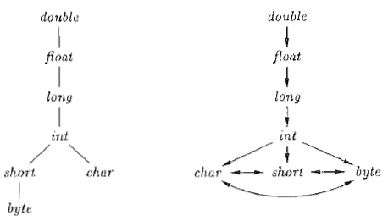
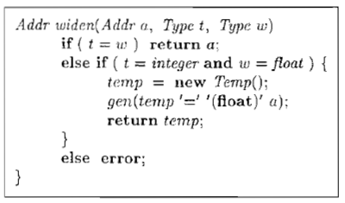
Type Conversion

Slide 44
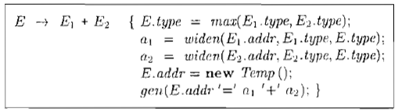
Type Conversion

Slide 45

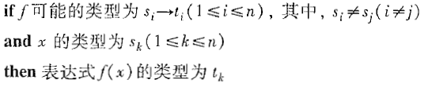
Overloading of Functions and Operators

Slide 46
5. Boolean Expressions
Boolean expressions are used in
Flows of control
Computing logical values

Slide 47
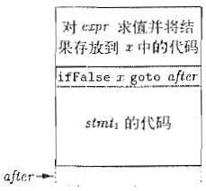
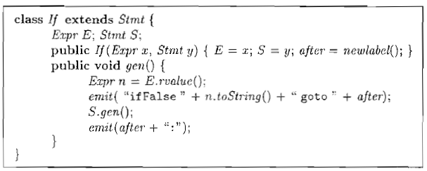
Example

Slide 48
Computing Logical Values
DBv1
a < b equals to if (a < b) then 1 else 0
E → E₁ or E₂ { E.place = new Temp();
emit(E.place '=' E₁.place 'or' E₂.place) }
E → E₁ and E₂ { E.place = new Temp();
emit(E.place '=' E₁.place 'and' E₂.place) }
E → not E₁ { E.place = new Temp();
emit(E.place '=' 'not' E₁.place) }
E → ( E₁ ) { E.place = E₁.place }
E → id₁ relop id₂ { E.place = new Temp();
emit('if' id₁.place relop.op id₂.place 'goto' currentStmt+3);
emit(E.place '=' '0');
emit('goto' currentStmt+2);
emit(E.place '=' '1') }
E → true { E.place = new Temp();
emit(E.place '=' '1') }
E → false { E.place = new Temp();
emit(E.place '=' '0') }

Slide 49
Computing Logical Values: An Example
DBv1
Source code
a < b or c < d and e < f
Intermediate code
100: if a < b goto 103 108: if e < f goto 111
101: t₁ = 0 109: t₃ = 0
102: goto 104 110: goto 112
103: t₁ = 1 111: t₃ = 1
104： if c < d goto 107 112: t₄ = t₂ and t₃
105: t₂ = 0 113: t₅ = t₁ or t₄
106: goto 108 114: ...
107: t₂ = 1

Slide 50
Short-Circuit Evaluation
Flow-of-Control Statements
S → if ( B ) S₁
S → if ( B ) S₁ else S₂
S → while ( B ) S₁
Short-circuit evaluation for && and ||
For higher evaluation efficiency
And ...

Slide 51
Generated Code Illustration
B.code
→ B.true
begin:
B.code
→ B.true
B.code
→ B.true
→ B.false
B.true:
S₁.code
→ B.false
→ B.false
B.true:
S₁.code
B.true:
S₁.code
goto S.next
B.false:
S₂.code
goto begin
B.false:
...
B.false:
...
S.next:
...
if
if-else
while

Slide 52
Syntax-Directed Definition for Flow-of-Control Statements
Where does
S.next come from ?
Productions | Semantic Rules
P → S | S.next = new Label(); P.code = S.code || label(S.next)
S → assign | S.code = assign.code
S → S₁ S₂ | S₁.next = new Label(); S₂.next = S.next; S.code = S₁.code || label(S₁.next) || S₂.code
S → if ( B ) S₁ | B.true = new Label(); B.false = S₁.next = S.next; S.code = B.code || label(B.true) || S₁.code
S → if ( B ) S₁ else S₂ | B.true = new Label(); B.false = new Label(); S₁.next = S₂.next = S.next; S.code = B.code || label(B.true) || S₁.code || gen('goto' S.next) || label(B.false) || S₂.code
S → while ( B ) S₁ | begin = new Label(); B.true = new Label(); B.false = S.next; S₁.next = begin; S.code = label(begin) || B.code || label(B.true) || S₁.code || gen('goto' begin)
Avoid redundant
gotos

Slide 53
Syntax-Directed Definition for Booleans
Productions | Semantic Rules
B → B₁ || B₂ | B₁.true = B.true; B₁.false = new Label(); B₂.true = B.true; B₂.false = B.false; B.code = B₁.code || label(B₁.false) || B₂.code
B → B₁ && B₂ | B₁.true = new Label(); B₁.false = B.false; B₂.true = B.true; B₂.false = B.false; B.code = B₁.code || label(B₁.true) || B₂.code
B → ! B₁ | B₁.true = B.false; B₁.false = B.true; B.code = B₁.code
B → E₁ relop E₂ | B.code = E₁.code || E₂.code || gen('if' E₁.addr relop.op E₂.addr 'goto' B.true) || gen('goto' B.false)
B → true | B.code = gen('goto' B.true)
B → false | B.code = gen('goto' B.false)
Short-Circuit
Evaluation

Slide 54
Syntax-Directed Translation: An Example
Source code
if (x < 100 || x > 200 && x != y) x = 0
Intermediate code
if x < 100 goto L₂
goto L₃
L₃: if x > 200 goto L₄
goto L₁
L₄: if x != y goto L₂
goto L₁
L₂: x = 0
L₁: ...

Slide 55
6. Backpatching and Flow-of-Control Statements
In SDD for Flow-of-Control Statements
Where does S.next come from ?
Only after all intermediate code are generated, can S.next be computed.
In SDD for Booleans
Where do B.true and B.false come from ?
Must be provided by the context of the boolean expressions.
The context depends on the result of S.next.

Slide 56
Design Motivation and Solution
Motivation
One-pass code generation
Solution
Using backpatching
It is a general approach to dealing with initial values which must be computed at the end.
If(B) S.

Slide 57
Backpatching for Boolean Expressions
Translation scheme
B → B₁ || M B₂ { backpatch(B₁.falseList, M.instruction);
B.trueList = merge(B₁.trueList, B₂.trueList);
B.falseList = B₂.falseList; }
B → B₁ && M B₂ { backpatch(B₁.trueList, M.instruction);
B.trueList = B₂.trueList;
B.falseList = merge(B₁.falseList, B₂.falseList); }
B → ! B₁ { B.trueList = B₁.falseList;
B.falseList = B₁.trueList; }
B → ( B₁ ) { B.trueList = B₁.trueList;
B.falseList = B₁.falseList; }
B → E₁ relop E₂ { B.trueList = new List(nextInstruction);
B.falseList = new List(nextInstruction + 1);
emit('if' E₁.addr relop.op E₂.addr 'goto __');
emit('goto __'); }
B → true { B.trueList = new List(nextInstruction);
emit('goto __'); }
B → false { B.falseList = new List(nextInstruction);
emit('goto __'); }
M → ε { M.instruction = nextInstruction; }

Slide 58
Backpatching for Flow-of-Control Statements
Translation scheme
S → if ( B ) M S₁ { backpatch(B.trueList, M.instruction);
S.nextList = merge(B.falseList, S₁.nextList); }
S → if ( B ) M₁ S₁ N else M₂ S₂
{ backpatch(B.trueList, M₁.instruction);
backpatch(B.falseList, M₂.instruction);
S.nextList = merge(S₁.nextList, N.nextList, S₂.nextList); }
S → while M₁ ( B ) M₂ S₁
{ backpatch(B.trueList, M₂.instruction);
backpatch(S₁.nextList, M₁.instruction);
S.nextList = B.falseList;
emit('goto' M₁.instruction); }
S → { L } { S.nextList = L.nextList; }
S → A ; { S.nextList = new List(); // Assignment or Atom }
M → ε { M.instruction = nextInstruction; }
N → ε { N.nextList = new List(nextInstruction);
emit('goto __'); }
L → L₁ M S { backpatch(L₁.nextList, M.instruction);
L.nextList = S.nextList; }
L → S { L.nextList = S.nextList; }

Slide 59
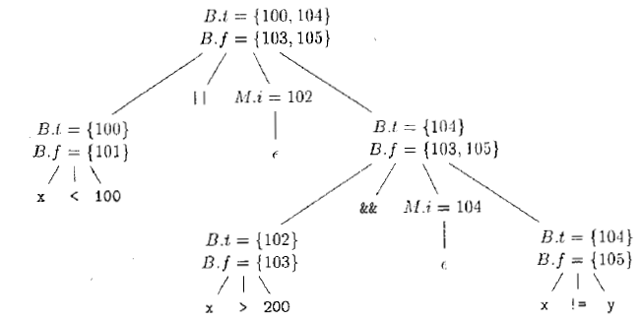
Example:

Slide 60
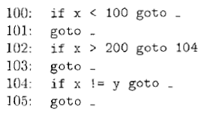
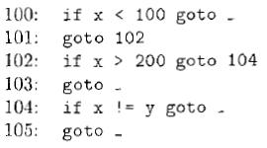
Example:

Slide 61
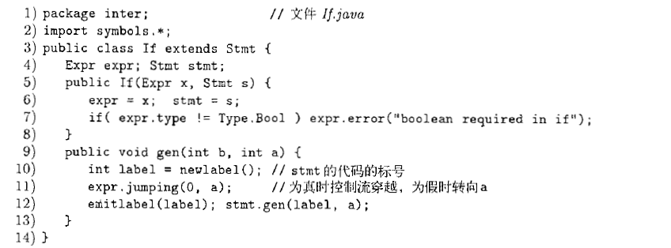
Example:

Slide 62
Exercise 9.1
What is the translation result of input token string: x := A[y, z] ?
Tips: use the translation scheme for Pascal.

Slide 63
Exercise 9.2
What is the translation result of input token string: c + a[i][j] ?
Tips: use the translation scheme for C/C++.

Slide 64
Exercise 9.3
What is the translation result of input token string: x < 100 || x > 200 && x != y ?
Tips: use the translation scheme for boolean expressions with backpatching.
Suppose that the start position of the generated code is 100.

Slide 65
Enjoy the Course!

